Slide 1
The Digital Camera

Slide 2
Objectives
Learn the construction of a camera to create digital images
Understand the difference of color systems, color spaces
Image formats, compressed images

Slide 3
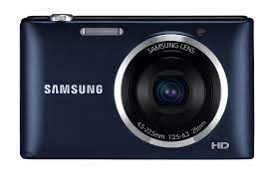
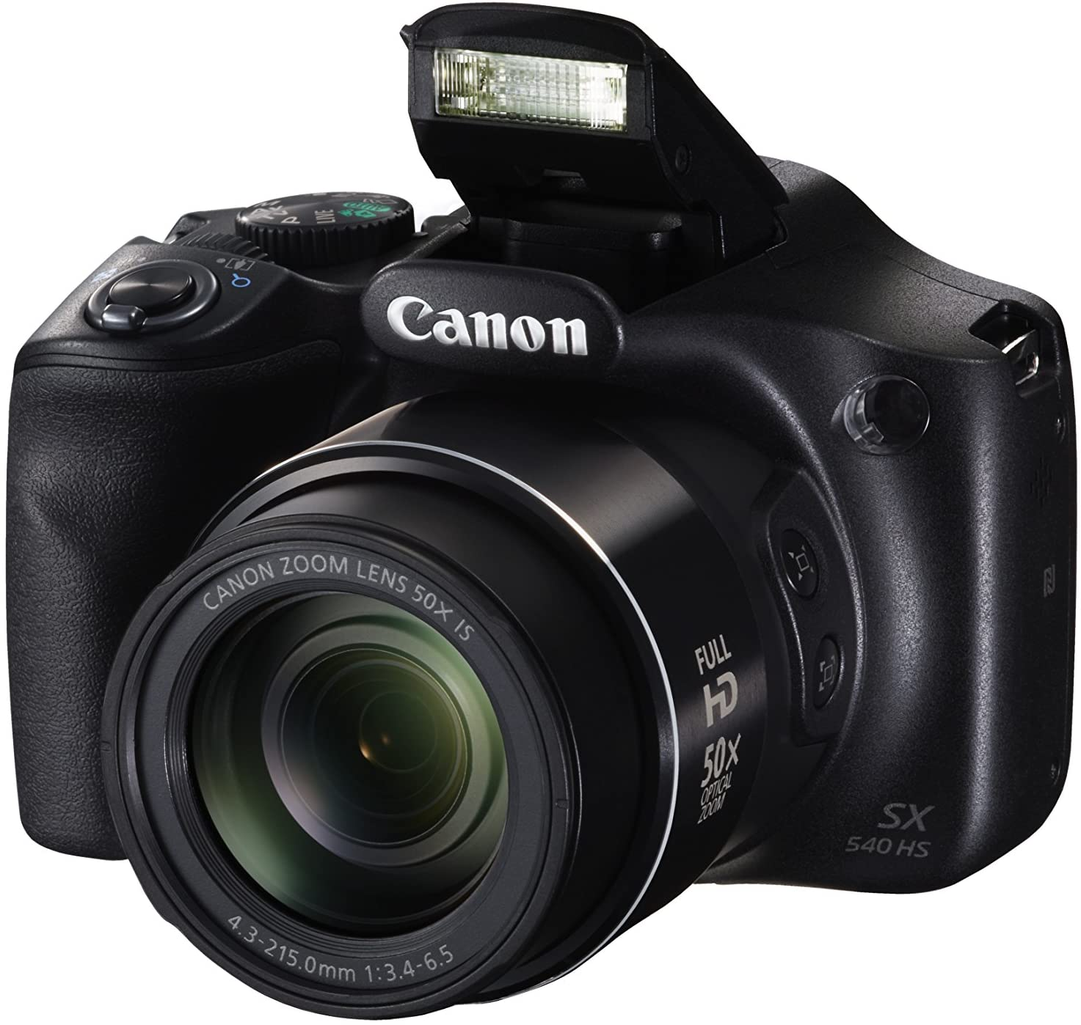
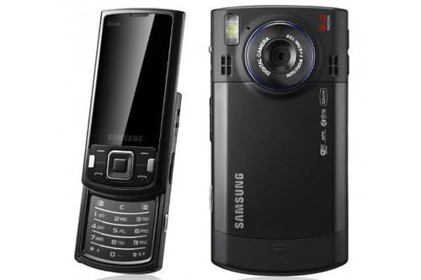
The Digital Camera
A digital camera is a camera that captures photographs in digital memory and the resulting files are in the format of digital images
Digital cameras using optical system, typically using a lens with a variable diaphragm to focus light onto an image pickup device

Slide 4
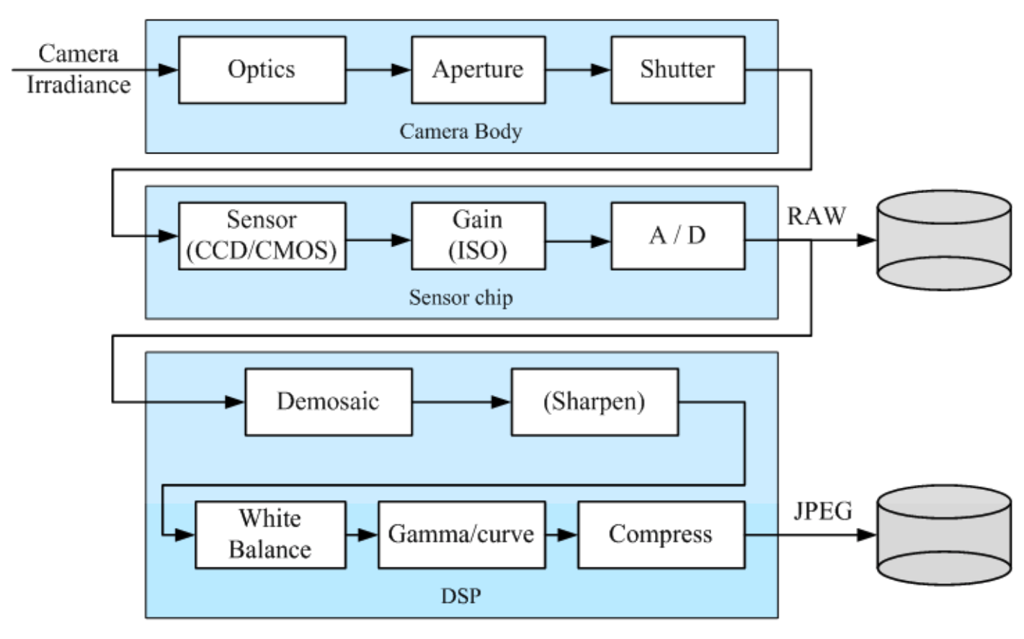
The Digital Camera
Camera models developed by Healey and Kondepudy (1994)
Notes:
After starting from one or more light sources, reflecting off one or more surfaces in the world, and passing through the camera’s optics (lenses), light finally reaches the imaging sensor. How are the photons arriving at this sensor converted into the digital (R, G, B) values that we observe when we look at a digital image?

Slide 5
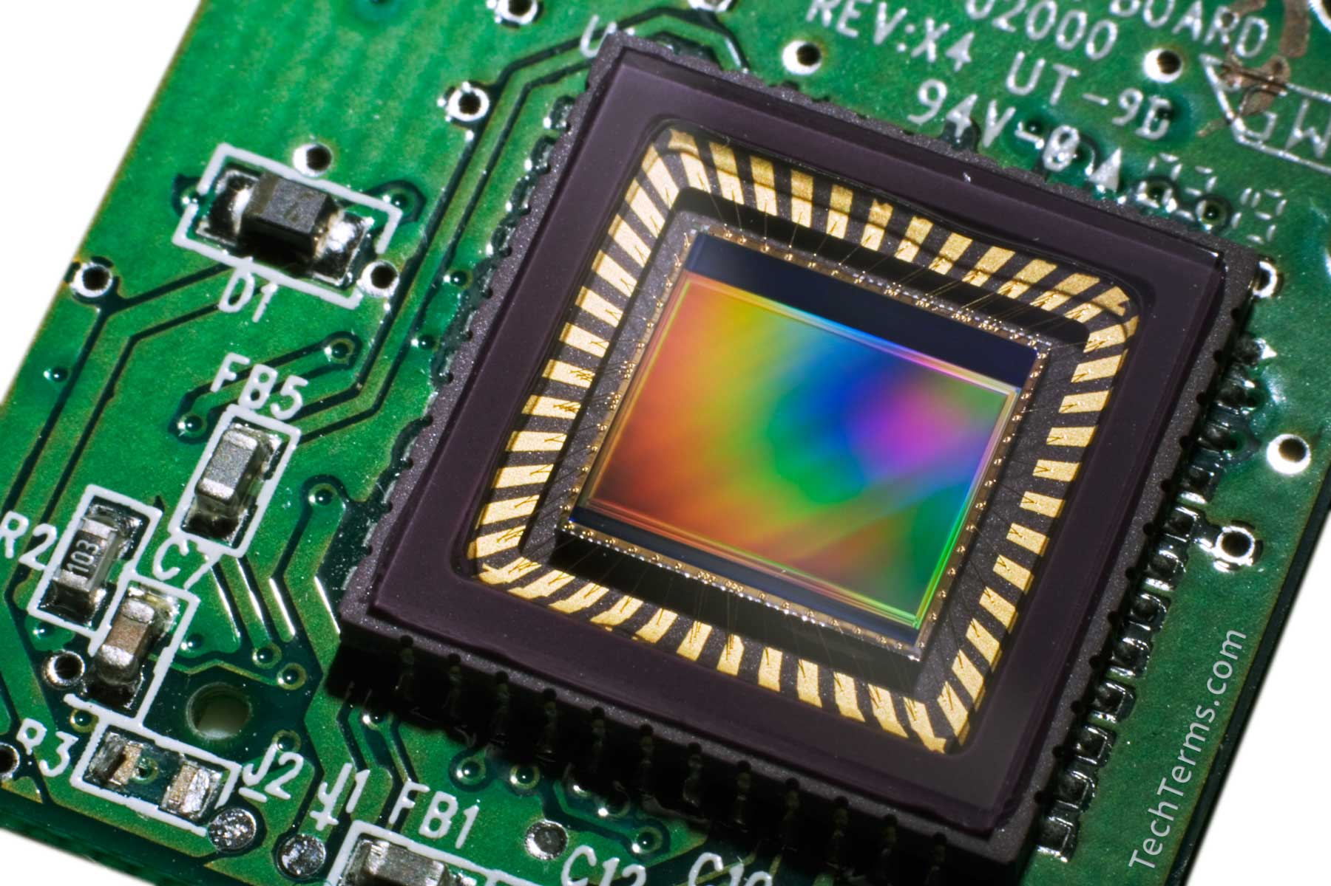
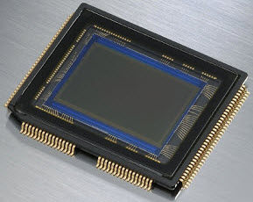
How Camera producce Images
The process:
Photons hit a detector
The detector becomes charged
The charge is read out as brightness
Sensor:
CCD (charge-coupled device)
Most common
High sensitivity
high power
Cannot be individually addressed
blooming
CMOS
simple to fabricate (cheap)
lower sensitivity, lower power
can be individually addressed
Notes:
CCD: It is a device used for the movement of electrical charge within it for the charge manipulation, which is done by changing the signals through stages within the device one at a time.

Slide 6
Camera parameters
Shutter speed: controls the amount of light reaching the sensor and, hence, determines if images are under or overexposed
Sampling pitch: the physical spacing between adjacent sensor cells on the imaging chip.
Fill factor: the active sensing area size as a fraction of the theoretically available sensing area.
Chip size:
Video and shoot cameras have traditionally used small chip areas ( 1/4 inch to 1/2 inch sensors)
Digital SLR cameras try to come closer to the traditional size 2 of a 35mm film frame.
Notes:
CCD: It is a device used for the movement of electrical charge within it for the charge manipulation, which is done by changing the signals through stages within the device one at a time.

Slide 7
Camera parameters
Automatic Gain Control (AGC): adjusting amplification and black level to get a “good fit” of the incident light power to the range of the image
Sensor noise: noise is added from various sources, which may include fixed pattern noise, dark current noise, shot noise, amplifier noise and quantization noise.
ADC resolution. The final step in the analog processing chain occurring within an imaging sensor is the analog to digital conversion.

Slide 8
Camera parameters
Digital post-processing. Once the irradiance values arriving at the sensor have been converted to digital bits, most cameras perform a variety of digital signal processing (DSP) operations to enhance the image before compressing and storing the pixel values
White balance: Adjustment of the mapping from measured spectral quantities to image RGB quantities

Slide 9
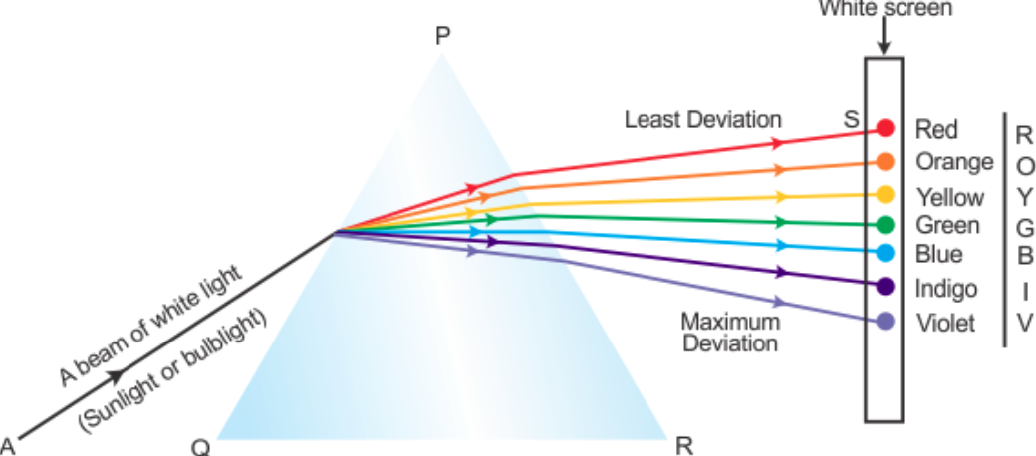
What is color
Color is the aspect of things that is caused by differering qualities of light being reflected or emitted by them.
To see color, we must have light. When light shines on an object some colors bounce off the object and others are absorbed by it. Your eyes only see the colors that are bounced off or reflected.

Slide 10
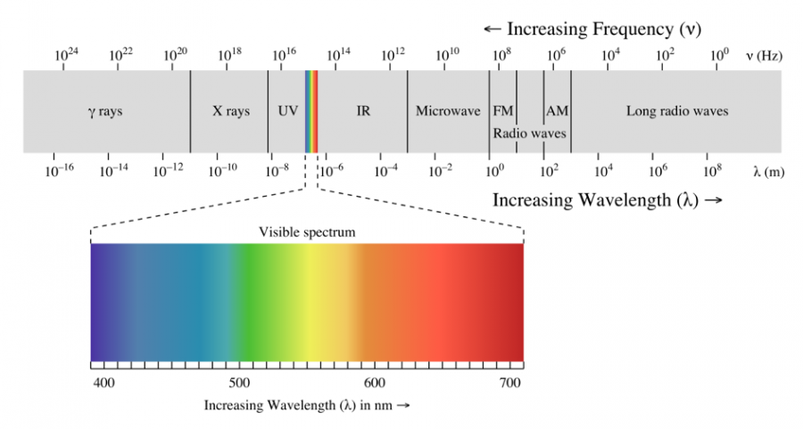
Human color can see

Slide 11
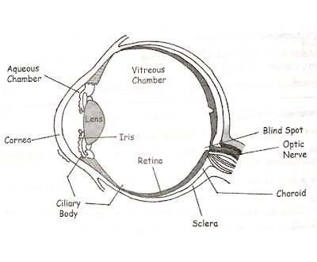
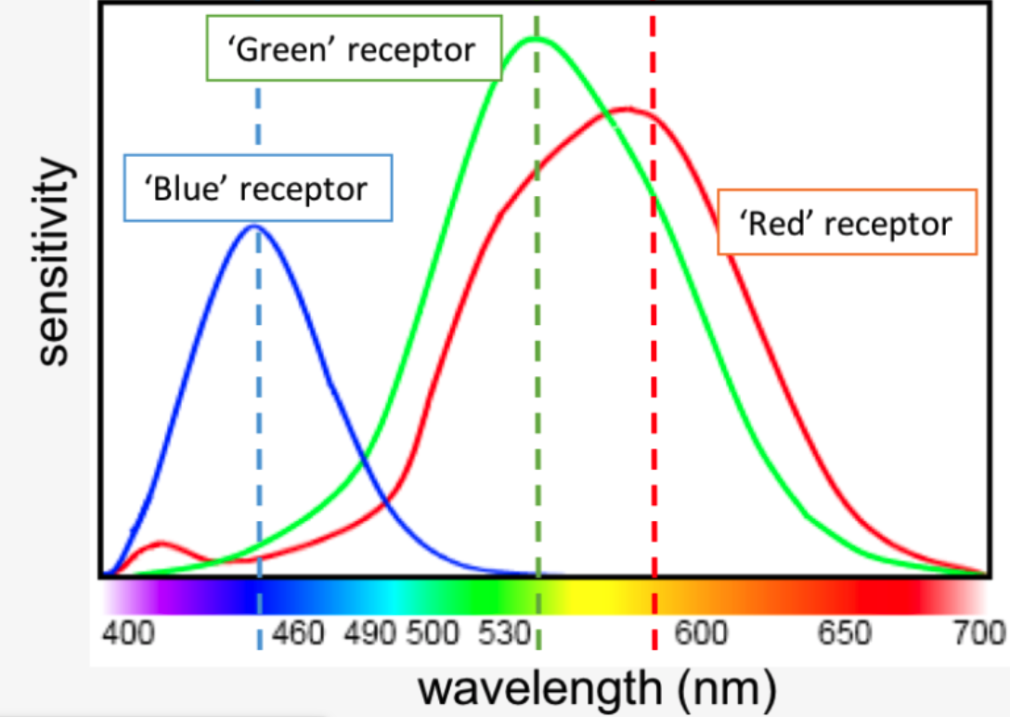
Human eyes
The human eye is nearly spherical in shape.
The wall of the eyeball comprises of three layers.
The outermost layer is sclera/ fibrous tunic.
Middle layer called vascular tunic ( choroid , ciliary body , iris )
Third which is the innermost layer is called retina (Retina is made of light sensitivity cells)
Notes:
Human eye is just like a camera. The lens focuses the light rays coming from outside onto light sensitive cells of retina. Light rays need to be bent or refracted to focus on retina and this refraction is done by curved cornea, eye lens and aqueous and vitreous humors.

Slide 12
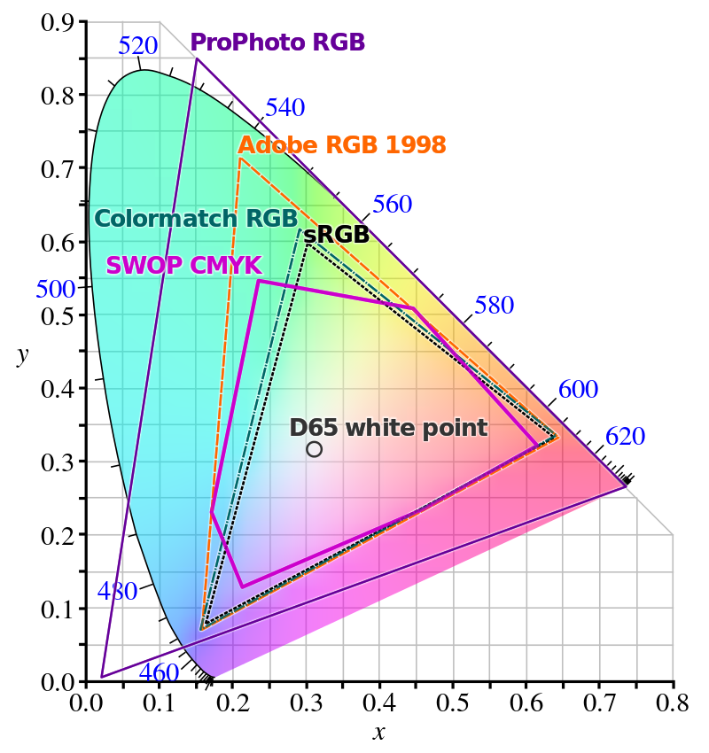
Color space
A color space is a specific organization of colors.
Color space:
CIE (Commission International d’Eclairage) establishes standards
CIE XYZ is a popular standard with everywhere positive response.
RGB requires a negative (subtractive) component in R response to render the complete color gamut of CIE XYZ.

Slide 13
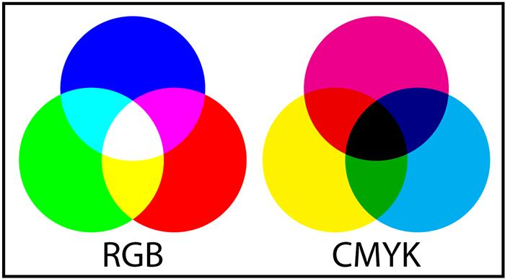
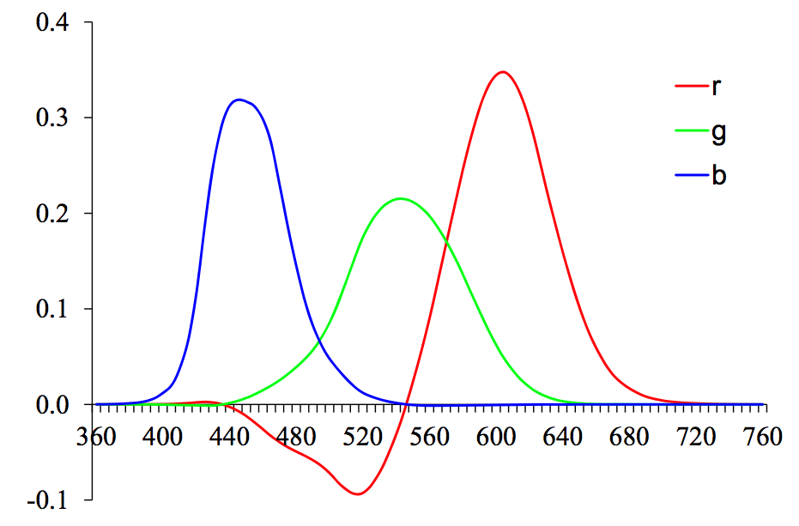
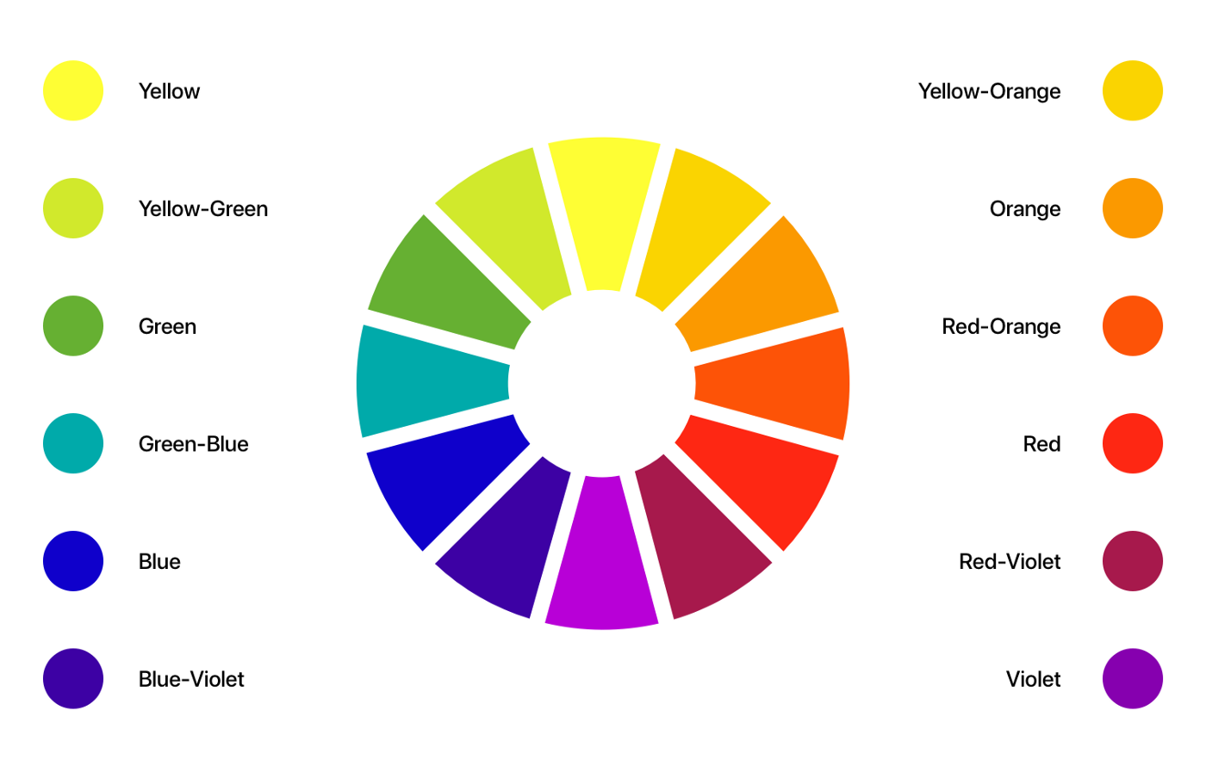
Color space
Standard CIE color matching functions
Notes:
Standard CIE color matching functions: (a) r ̄(λ), g ̄(λ), ̄b(λ) color spectra obtained from matching pure colors to the R=700.0nm, G=546.1nm, and B=435.8nm pri- maries;
RGB, CMYK, HUE

Slide 14
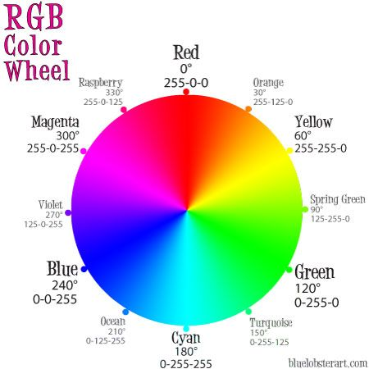
Color space
Accurate color reproduction is commercially valuable
Many products are identified by color
Few color names are widely recognized by English speakers
About 10 languages
Personal name --> disagree. •
Color reproduction problems increased by prevalence of digital imaging
Ensure that everyone sees the same color.

Slide 15
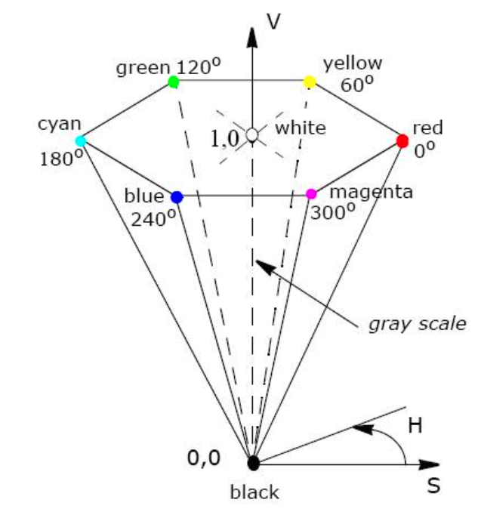
Color space: HSV
Every color is represented by three components Hue ( H ), Saturation ( S ) and Value ( V )
The Hue component describes the color itself in the form of an angle between [0,360] degrees: 0 degree mean red, 120 means green 240 means blue, 60 degrees is yellow, 300 degrees is magenta.
The Saturation component signals how much the color is polluted with white color: the range of the S component is [0,1].
Black has a V coordinate of 0. At this point the values of H and S are irrelevant. The point S=0, V=1 is white. Intermediate values of V for S=0 (on the center line) are the grays. When S=0 value of H is irrelevant (called by convention undefined). When S is not zero, H is relevant.

Slide 16
Color space: YCbCr
It is used as a part of the color image pipeline in video and digital photography systems.
Y is the luma component and CB and CR are the blue-difference and red-difference chroma components.
It is used for JPEG conversion
Notes:
Picture : A color image and its Y′, C_{B} and C_{R} components. The Y′ image is essentially a greyscale copy of the main image.

Slide 17
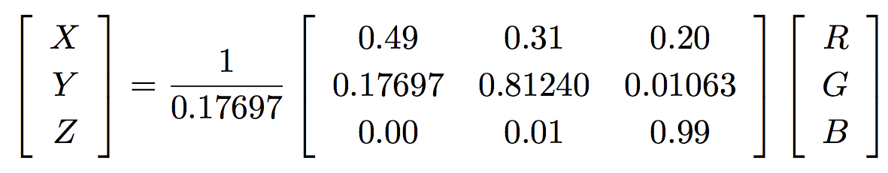
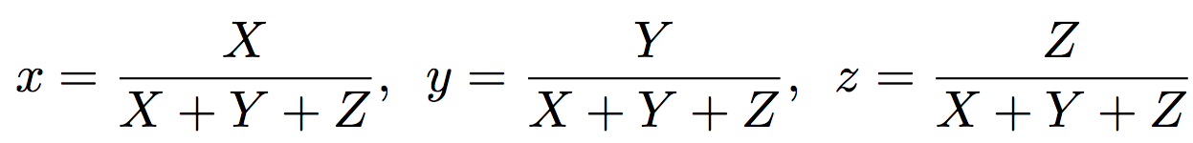
Color Transformation
The transformation from RGB to XYZ is given by:
Chromaticity coordinates
Notes:
Standard CIE color matching functions: (a) r ̄(λ), g ̄(λ), ̄b(λ) color spectra obtained from matching pure colors to the R=700.0nm, G=546.1nm, and B=435.8nm pri- maries;
RGB, CMYK, HUE

Slide 18
Color Transformation
Color filter arrays: cameras use a color filter array (CFA), where alternating sensors are covered by different colored filters
Color balance: attempt to move the white point of a given image closer to pure white (equal RGB values)

Slide 19
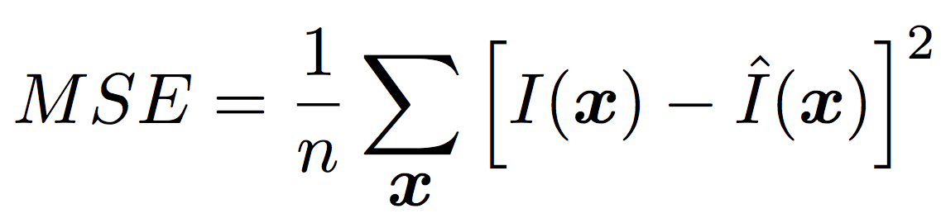
Compression
The last stage in a camera’s processing pipeline is usually some form of image compression
Image compression algorithms start by converting the signal into YCbCr
Technique : Discrete Cosine Transform (DCT), which is a realvalued variant of the discrete Fourier transform (DFT)
The quality of a compression algorithm: peak signal-to-noise ratio (PSNR):

Slide 20
Image Storing
Non-lossy schemes
pbm/pgm/ppm/pnm: code for file type, size, number of bands, and maximum brightness
tif (lossless and lossy versions)
bmp
gif (grayscale)
Lossy schemes
gif (color)
jpg
Uses Y Cb Cr color representation;
subsamples the color
Uses DCT on result
Uses the fact the human system is less sensitive to color than spatial detail

Slide 21

TIFF IMAGE FORMAT
TIFF(TaggedImageFileFormat)
More general than GIF
Allows 24 bits/pixel
Supports 5 types of image compression including:
RLE (Run length encoding)
LZW (Lempel-Ziv-Welch)
JPEG (Joint Photographic Experts Group)
Notes:
Hình hoa được nén dùng tỷ lệ nén ảnh càng suy giảm khi nhìn từ bên trái tới bên phải

Slide 22
Summary
Learn the construction of a camera to create digital images
Understand the difference of color systems, color spaces
Image formats, compressed images.

